Slide 1
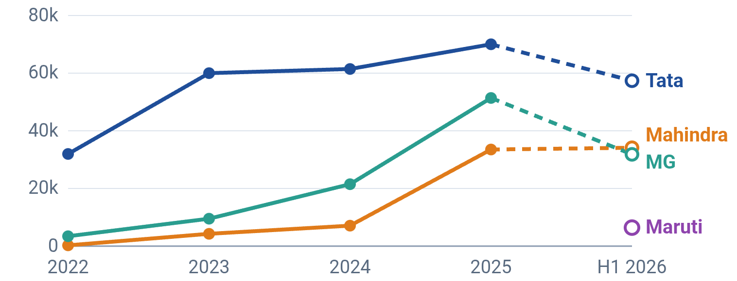
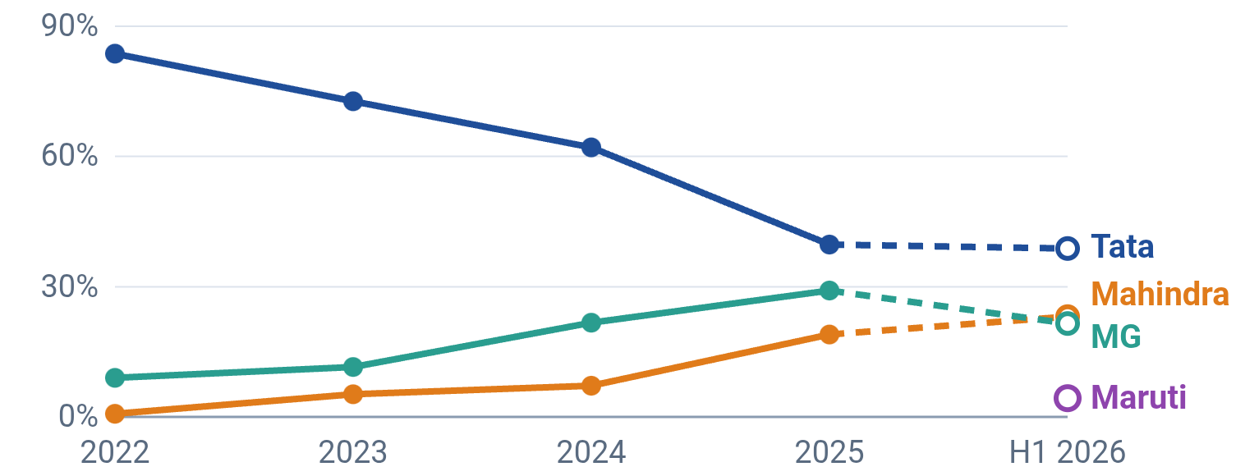
Tata still leads, but Mahindra and MG have cut its share in half
INDIA ELECTRIC PASSENGER VEHICLES · OEM-WISE RETAIL SALES
Sales volume (units)
Sales volume trend (units)
Year | Tata | Mahindra | MG | Maruti | Total e-PV
2022 | 31,972 | 280 | 3,429 | – | 38,209
2023 | 60,007 | 4,269 | 9,523 | – | 82,563
2024 | 61,435 | 7,104 | 21,464 | – | 99,004
2025 | 70,004 | 33,513 | 51,387 | – | 176,538
H1 2026 | 57,380 | 34,131 | 31,819 | 6,404 | 148,023
Market share (% of total e-PV)
Market share trend (%)
Year | Tata | Mahindra | MG | Maruti | Top 4
2022 | 83.7% | 0.7% | 9.0% | – | 93.4%
2023 | 72.7% | 5.2% | 11.5% | – | 89.4%
2024 | 62.1% | 7.2% | 21.7% | – | 91.0%
2025 | 39.7% | 19.0% | 29.1% | – | 87.8%
H1 2026 | 38.8% | 23.1% | 21.5% | 4.3% | 87.7%
Source: Vahan retail registrations, via Autocar Professional, Autocar India, Electrive, e-Vehicleinfo · Dashed line / hollow marker = H1 2026 (Jan–Jun)
Notes:
Calendar-year retail registrations (Vahan). H1 2026 covers January to June only, so it is shown dashed and is not directly comparable with full years. Maruti Suzuki entered with the e-Vitara in January 2026, so it has no earlier data. 2025 figures are the early-January 2026 Vahan snapshot; later Vahan updates revised the CY2025 total upward to about 194,646 units (Tata 76,629, Mahindra 37,235). Market share is each OEM's units divided by total e-PV units for that period. Mahindra overtook MG for the No. 2 spot in March 2026.

Slide 2
EV Policies in India: Present Status (Oct 2026)
Policy | What it supports | Outlay | Tenure | Status | Latest update
PM E-DRIVE: e-2W & e-3W subsidy | Purchase incentive for e-2W, e-rickshaws, e-carts and L5 e-3W | ₹11,900 cr (whole scheme) | Oct 2024 – Mar 2028 | Extended | e-2W extended to Mar 2028 (Aug 2026): ₹2,500/kWh, max ₹5,000. L5 e-3W closed Dec 2025 after hitting target.
PM E-DRIVE: buses, trucks & charging | 14,028 e-buses, e-trucks, e-ambulances, ~72,000 public chargers | Part of ₹11,900 cr | To Mar 2028 | In progress | Buses allocated: Bengaluru ~4,500, Delhi 2,800, Hyderabad 2,000. ₹500 cr each for e-trucks and e-ambulances.
PLI Auto | Sales-linked incentive for advanced auto tech, incl. EVs and parts | ₹25,938 cr | FY24 – FY28 | Disbursing | ₹2,322 cr paid by Dec 2025; ₹35,657 cr invested by applicants (Sep 2025).
PLI ACC (battery cells) | 50 GWh of domestic advanced-chemistry cell capacity | ₹18,100 cr | Approved May 2021 | Lagging | 40 GWh awarded (Ola 20, Reliance 15, Rajesh Exports 5); ~1 GWh commissioned (Mar 2026).
SPMEPCI (EV car import) | 15% import duty on EVs for makers investing ≥₹4,150 cr locally | Duty foregone | Notified Jun 2025 | Stalled | No OEM applied; application portal shut (Jan 2026).
REPM (rare-earth magnets) | Sintered magnet plants for EV motors, 6,000 tonnes a year | ₹7,280 cr | 7 yrs (2 build + 5 incentive) | Bidding | Tender Mar 2026; 20 bids received (Aug 2026) for 5 slots; awards pending.
Source: Ministry of Heavy Industries data via Autocar Professional, Electrive, pv magazine India, Angel One · Status as of Oct 2026
Notes:
PM E-DRIVE replaced FAME II in October 2024 with an initial outlay of Rs 10,900 crore, raised to Rs 11,900 crore in August 2026, almost entirely for electric two-wheelers. The e-2W subsidy covers up to about 4.58 million vehicles with an ex-factory price up to Rs 1.5 lakh; claims close 31 December 2027. Electric cars get no PM E-DRIVE purchase subsidy. SPMEPCI: Tesla, Hyundai and Volkswagen showed interest but did not formally apply. REPM bidders include L&T and Coal India.

